Slide 1

Shipping Event API – Version 1.0

Slide 2
Content
Background of the OpenShipping.org initiative
Introduction to the Shipping Event API, scope and overview
The logical model behind Milestone Events
Documentation of the Schema Structure, defining API content
Links and wrap up

Slide 3
OpenShipping.org
How OpenShipping got started, goals and ambitions, and how it has evolved

Slide 4
OpenShipping.org Background and Current Status
OpenShipping.org was kicked off by NYSHEX in 2018. The aim of OpenShipping.org is to informally facilitate knowledge sharing and alignment on common designs with regards to API specifications within the shipping, transport and logistics industry.
The collaboration model of OpenShipping.org has all along been somewhat of “grassroot” level, with the main focus on content, pitched in by those who had designs to share. Thus, the topics have similarly evolved over the year’s time of OpenShipping.org’s existence.
Beyond conference calls and the work which has naturally been put into designs in between meetings, the following are noteworthy physical workshops held so far in OpenShipping.org context (TODO: complete lists of participants):
Hapag Lloyd’s office in Hamburg, Germany, June 2018. Participating organizations included NYSHEX, MSC, CMA-CGM, Hapag-Lloyd, OOCL, Maersk Line and TradeLens.
Navis’ office in Oakland, California, July 2018. Participating organizations included INTTRA, Navis, Turvo, CMA-CGM and TradeLens.
CMA-CGM’s office in Marseille, France, October 2018. Participating organizations included CMA-CGM, Hapag-Lloyd, Maersk Line, Traxens and TradeLens.
The OpenShipping.org website hosts the OpenShipping.org charter. It also links to the OpenShipping.org github project, where shared material can and was expected to be shared. As it has turned out however, since the initial Hamburg meeting, material has been primarily communicated via API specifications on swaggerhub.

Slide 5
Shipping Event API
Recent carrier-driven initiative of defining a common shipping events API

Slide 6
Targeted Scope, Processes and Technology
This slide deck documents the part of the OpenShipping.org material which has been driven primarily by participating shipping lines since the October 2018 workshop. The majority of the content has been agreed among all OpenShipping.org participants – importantly decisions about which existing standard to build upon (listed on a later slide). But the shipping lines’ latest contributions focus specifically on use cases around:
Shipping milestone planning and execution,
Shipping events, particularly such generated by emerging IoT device technologies
In the spirit of OpenShipping.org, our technical starting point is naturally modern HTTP-based API technologies.
Functionally, our ambition has been to specify a design which:
Is common among participating carriers’ booking, planning and operational processes. (TODO: should we call out “Containerized business”?)
Doesn’t deviate significantly from known back office systems, ensuring that subsequent data mapping is manageable.
Is rooted in – and builds upon – existing standards.
Breaks down barriers to entry by applying generic, logical models and self-explanatory naming.
Common for the targeted use cases, legacy systems and emerging IoT devices is that communication is event-driven. What this means is that a heterogeneous landscape of actors (human, organizations, devices, etc) emit statuses on a near-real time, best-effort basis. Similarly, a heterogeneous landscape of actors receive and react on these events. The individual event aims to communicate what has happened, but does not imply how this information is to be used – it is left to the receiver how to action received events, including keeping state. This is in contrast to other communication paradigms, notably REST, which is very commonly implemented over APIs, leveraging HTTP’s verbiage for also communicating how data is intended to be stored and manipulated. This is a very practical pattern in many situations, but less suitable for the targeted use cases in the heterogeneous landscape of shipping. Practically, this results in an all HTTP POST API, requiring business logic to properly react. As mentioned above, 1) such business exists in legacy systems throughout the industry, and 2) significant emphasis has been put on the aspects of genericness, logic and simplicity.
Please note that the current version of the API is a baseline, not necessarily a final version. It covers the particular scope just described, and there is obviously many other aspects to global transport and trade which may be added in future releases.

Slide 7
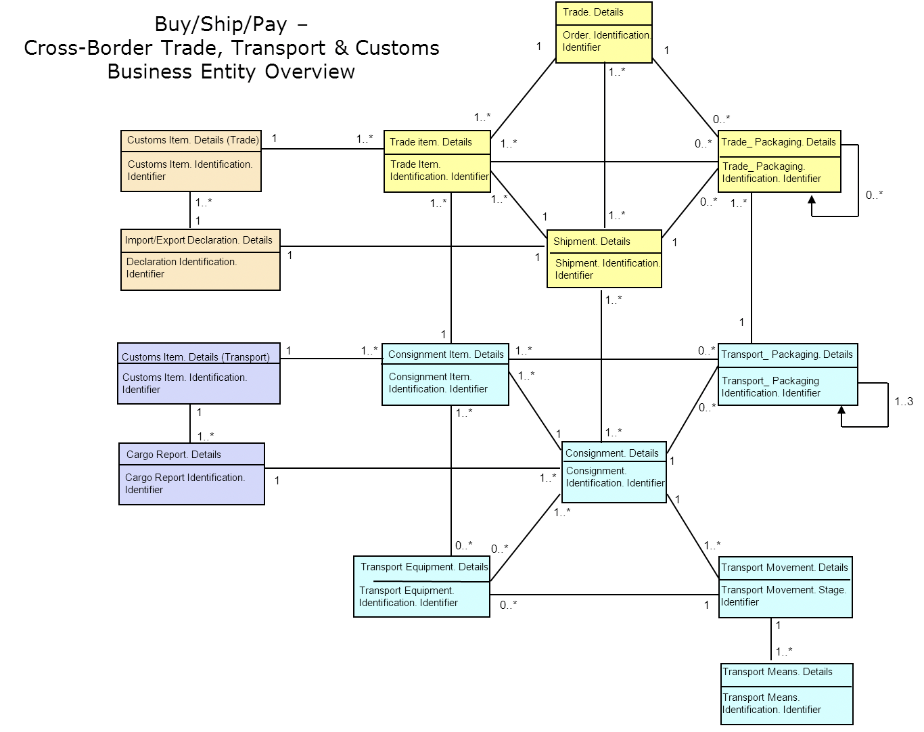
UN/CEFACT Foundation
The Event API allows for publishing Consignments and Transport Equipment as events through a POSTing alongside the events, meant to serves as the context of those subsequent events.
These are direct implementations of the Consignment and Transport Equipment classes of the UN/CEFACT Supply Chain Reference Data Model (SCRDM)’s Buy-Ship-Pay model. The Consignment represents the contract of transport and the Transport Equipment used for that transport – all of interest to varying parties involved at each level.
These form a hierarchy, with Transport Equipment sitting underneath a Consignment. Consignment also hold parties. Planned events relate to Consignments; Estimated and Actual events relate to Transport Equipment.
From the perspective of common carrier business processes, the Consignment roughly represents the booking confirmation, whereas the Transport Equipment represents the equipment matching (when a physically identified container has been assigned to the consignment).
Shipment plays an important role, but has not yet been included in this first version of the API entirely due to scope confinement. The Shipment class represents the traded of goods inside the containers, and are of important relevance to authorities, financial institutions, sellers and sellers. It is worth noting that LCL tracking should be done through the Shipment class, so the current version of the API is only meant to deal with FCL. We consider adding the Shipment class a natural future extension of the API.
It is also worth pointing out that consignments are commonly referred to as “shipments” in the carrier business (because carriers don’t need to distinguish). However, in order to accommodate the larger industry, and for general clarity, we fully embrace UN/CEFACT’s clear definitions, explicitly distinguishing between Trade Data (yellow) and Transport Data (blue).
Movement and Means are implemented in the Milestone events. Both are represented in the resource model, available through the Milestone event endpoints.

Slide 8
Additional Adopted Standards
UN/CEFACT Smart Container project under transports and logistics for tracking and monitoring physical trip execution, implemented in the SmartEvent endpoints.
UN/CEFACT Code List recommendation 24, supported through the generic events.
UN/Locode, implemented at attribute level for geographical locations
SMDG, implemented at attribute level for terminal identification
IMO, implemented at attribute level vessel identification
ISO 8601, implemented at attribute level for time and timezone representation
ISO 6346, implemented at attribute level for container identification

Slide 9


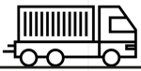

Event Flow Example
Carrier:
”I just confirmed booking CMA32112!”
“Here’s how I plan to carry it out”
”These are the containers we’ll be using”
BCO:
“Gotcha, storing the Consignment”
“Okay, Storing the plan”
“OK, Registering those TEs
under the Consignment”
“I know that one,
it’s part of CMA32112”
“Excellent, all set
on export side then!”
Consignment
POST /Consignment
Planned Load 26/3
Planned Departure 27/3
Planned Arrival 14/4
POST /PlannedLoad
POST /PlannedDeparture
POST /Planned Arrival
Equipment
POST /TransportEquipment
POST /TransportEquipment
Gated in 25/3
Loaded 26/3
Equipment
Truck:
”Just gated in container ABC2134”
Loaded 26/3
POST /ActualGateIn
Terminal:
”Just gated in container ABC2134
And DEF6879”
POST /ActualGateIn
POST /ActualGateIn

Slide 10
Event Endpoint Overview
 | Plan Event Endpoints POST consignments​/{consignmentRef}​ | Estimate Event Endpoints POST /transportEquipment​/{equipmentNumber} | Actual Event Endpoints POST /transportEquipment​/{equipmentNumber}
Milestone Events | /plannedVesselLoads /plannedVesselDepartures /plannedVesselArrivals /plannedVesselDischarges /plannedTruckLoads /plannedGateOuts /plannedGateIns /plannedTruckDischarges /plannedRailLoads /plannedRailDepartures /plannedRailArrivals /plannedRailDischarges /plannedBargeLoads /plannedBargeDepartures /plannedBargeArrivals /plannedBargeDischarges | /estimatedVesselLoads /estimatedVesselDepartures /estimatedVesselArrivals /estimatedVesselDischarges /estimatedTruckLoads /estimatedGateIns /estimatedGateOuts /estimatedTruckDischarges /estimatedRailLoads /estimatedRailDepartures /estimatedRailArrivals /estimatedRailDischarges /estimatedBargeLoads /estimatedBargeDepartures /estimatedBargeArrivals /estimatedBargeDischarges | /actualVesselLoads /actualVesselDepartures /actualVesselArrivals /actualVesselDischarges /actualTruckLoads /actualGateIns /actualGateOuts /actualTruckDischarges /actualRailLoads /actualRailDepartures /actualRailArrivals /actualRailDischarges /actualBargeLoads /actualBargeDepartures /actualBargeArrivals /actualBargeDischarges
Smart Events |  | /estimatedSmartEvent | /actualSmartEvent
Generic Events | /plannedGenericEvent | ​/estimatedGenericEvent | /actualGenericEvent

Slide 11
Where Events Occur
All Milestone events occur within a defined location (UNLOCODE location and SMDG Terminal).
Smart Events occur continuously along each leg (GPS Coordinates), between locations.
Generic Events may not relate to any kind of location at all, e.g. if related to documentation.

Slide 12
Milestone Events
The logical model which structures Milestone Events

Slide 13
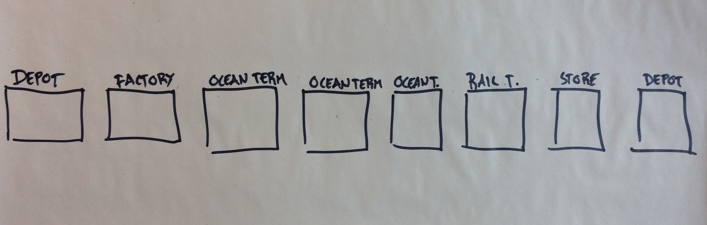
Milestone Event Model – Locations
The Milestone events are modular, and can model any Consignment’s multi-modal transport plan. This reflects the various locations which the Equipment needs to moving move between for contractual and operational purposes.

Slide 14
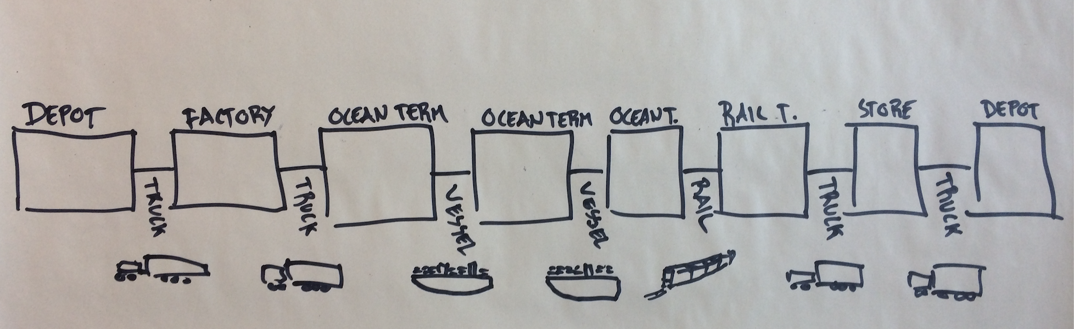
Milestone Event Model – Legs
Equipment is moved between locations by various means of transport. Such “legs” can be considered the edges connecting location nodes.

Slide 15
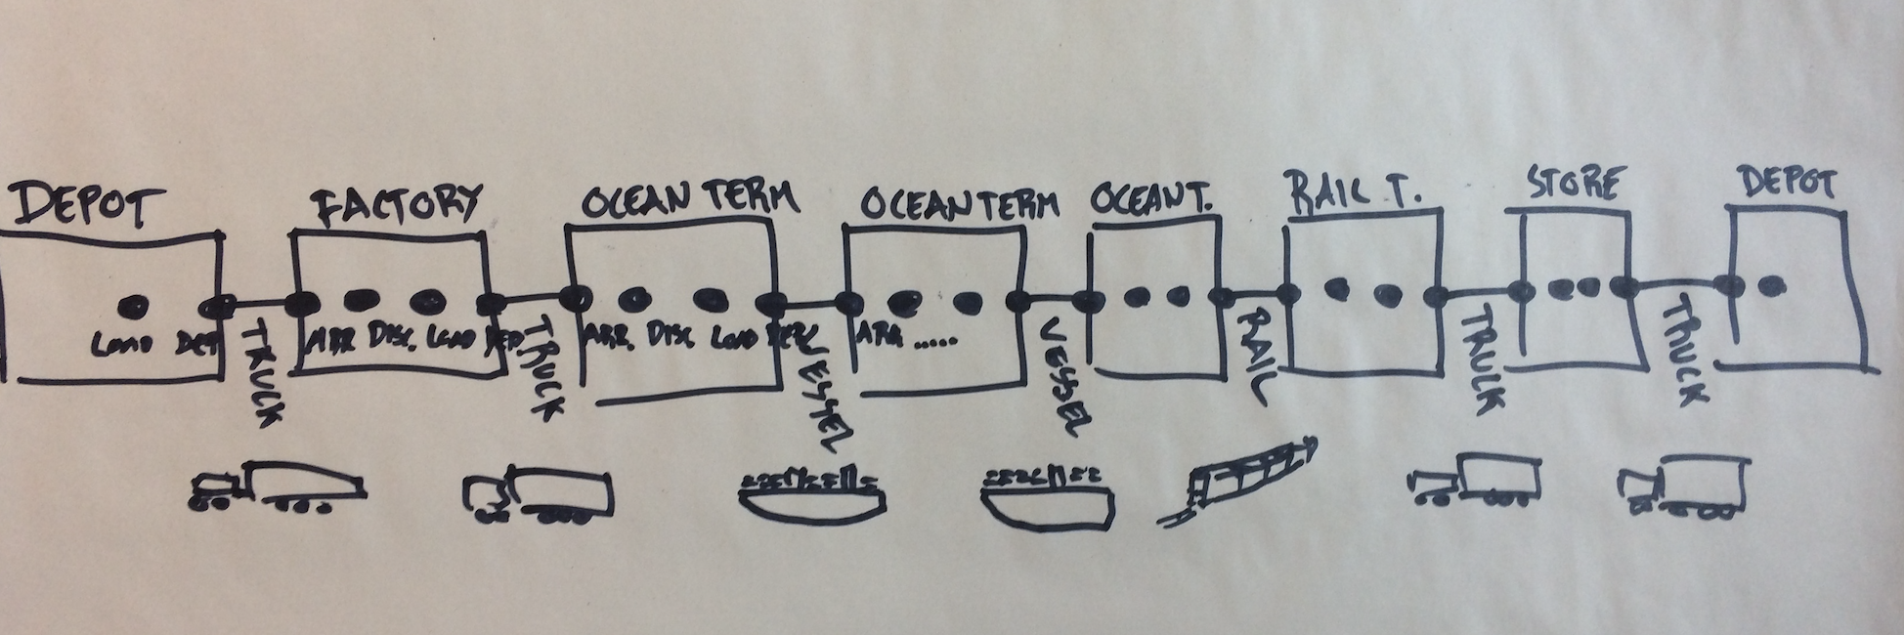
Milestone Event Model – Four Events Per Leg
Each leg are represented consistently as four distinct, key milestone events representing how containers are first loaded, then departs from one location, arrives at a different location, and is discharged from that means of transport. This cycle is repeated for each leg of the transport plan.

Slide 16
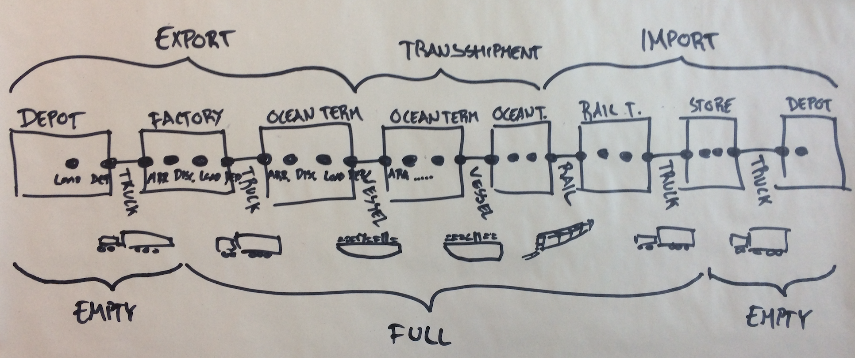
Milestone Event Model – Phase and FullStatus
Through the journey, the container changes status, from export to import, and empty to full and then again empty. These statuses are represented as attributes on the events.

Slide 17
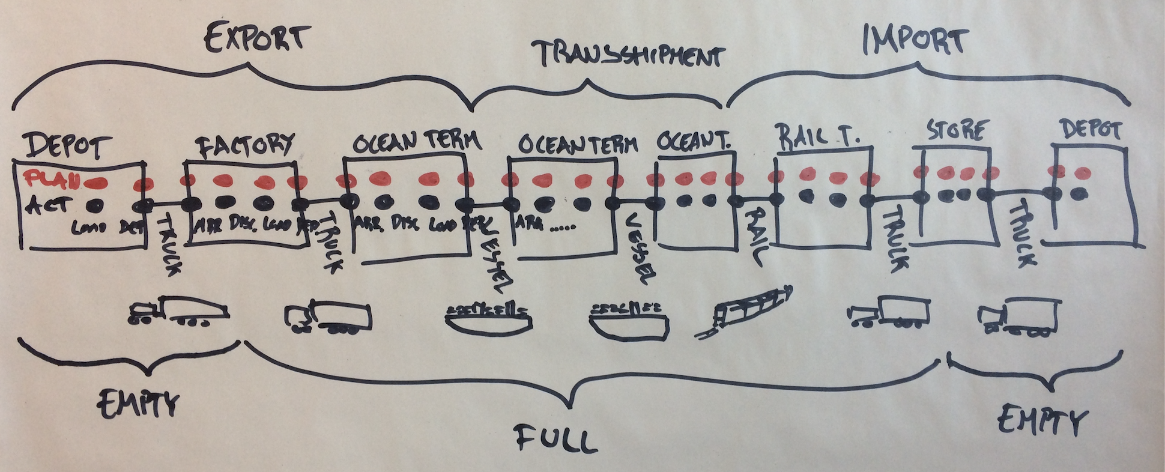
Milestone Event Model – Planned, Estimated, Actual
Finally, each event comes in three types: planned, representing how the carrier intends to carry out the transport, estimated, which can be signaled along the way (not shown below), and actual, when the milestone event has been carried out.

Slide 18
Milestone Event Model Summary
A transport plan Leg is described by four events:
Load
Departure
Arrival
Discharge
This, in turn, come in three flavors:
Planned – what is supposed to happen
Estimated – what and when events are expected to happen
Actual – what has indeed happened
Legs are joined together to form a full Consignment transport plan. Leg-joining happens at terminals.
Note that Planned events relate to Consignments, whereas Estimates and Actuals relate to Equipment. This reflects that carriers plans for the full consignment, but containers are in reality moved individually.

Slide 19
Milestone Event Model Overview
There are different events for four types of legs:
Truck
Rail
Barge
Vessel
The event model thus consists of a total of 48 events – i.e. endpoints.
This model is easily extensible (e.g. adding an “Air” leg type).
While the event model is strictly logical, the naming of individual events are made to embrace common industry lingo. E.g. “Gate out” instead of ”Truck departure”.

Slide 20
Milestone Event Example

Slide 21
Schema Structure
Payload object structure documentation

Slide 22
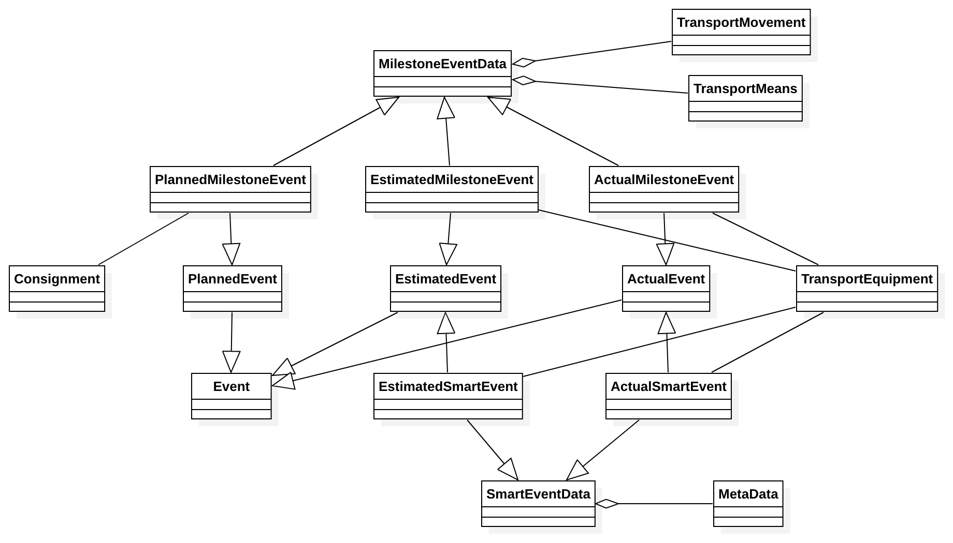
API Schema Structure
What are the objects to be tracked?
Consignment:
A consignment is a separately identifiable collection of Container Transports (available to be) transported from one Consignor to one Consignee via one or more modes of transport as specified in one single transport service contractual document.
TransportEquipment:
A piece of equipment used to hold, protect or secure cargo for logistics purposes. Transport Equipment are assigned to consignment when its transport execution starts.
Both transport equipment and consignment data serve as context of the tracking events.

Slide 23
API Schema Structure
What is basically a tracking event?
Event:
The model relies on a main generic entity “Event” which provides a generic pattern to describe a tracking event.
Two types of events will be described later: Milestones & Smart Events.
“Event” properties
Property Name | Property Description
eventCodeType | string example: CEFACT Recommendation 24 This can link to coded event standards, such as 'EDIFACT' or 'CEFACT Recommendation 24'.
eventCodeValue | string The code as per the above codification scheme. example: 359
eventCodeDescription | string Description as per the codeification scheme. example: Bill of Lading issued
eventTime | string($date-time) Time of the event occurrance, in ISO 8601 format
originatorId | string SCAC code of the organization that published this event
correlationId | string ‘Technical’ User-supplied ID for this event

Slide 24
API Schema Structure
When the events could be registered? … the trip plan
PlannedEvent:
Planned events are submitted by the carrier, responsible for executing a consignment as per the agreement of the booking.
A consignment trip plan might be updated (e.g. due to route change), and thus planned events could be grouped according to a plan reference or revision.
“PlannedEvent” inherit from “Event”, with the below additional properties.
Property Name | Property Description
consignmentRef | Consignment identifier, carrier assigned reference number assigned by a carrier of its agent to identify a specific consignment such as a booking reference number when cargo space is reserved prior to loading. "BN" as defined in http://www.unece.org/fileadmin/DAM/trade/untdid/d16b/tred/tred1153.htm This property allows to link the event to a consignment context.
planRef | string Common reference used across a set of planned events, in order to associate them to the same plan.

Slide 25
API Schema Structure
When the events could be registered? …during trip plan execution
EstimatedEvent:
Estimated events can be submitted by participants of the consignment execution. They represent how the planned events are expected to be executed.
An estimated event is related to one of the transport equipment. It might affect the consignment plan, but it does not automatically change it.
ActualEvent:
Actual events register details of events which has already been occurred.
“EstimatedEvent” & “ActualEvent” inherit from “Event”, with the below additional properties.
Property Name | Property Description
equipmentNumber* | string ISO 6346 goverend number, physically printed on the equipment. This represents UN/EDIFACT's "EQ" code. Number assigned by the manufacturer to specific equipment. (http://www.unece.org/fileadmin/DAM/trade/untdid/d16b/tred/tred1153.htm) This property allows to link the event to a transport equipment context.
gpsLocation | The GPS coordinates of event location (longitude, altitude)

Slide 26
API Schema Structure
Tracking events could be the physical moves…
Planned/Estimated/Actual MilestoneEvents
Milestones events inherit from generic events, with additional specific “MilestoneEventData” composed of:
Property Name | Property Description
location | string The UN/LOCODE where the event occurred. example: AUSYD
terminal | string SMDG code of the terminal where the event took place. example: USMOB-APMTSMDG
transportationPhase | string The transportation phase. example: Import
fullStatus | string Indication of whether the container is full or empty. example: Full
Transport Movement | Object The conveyance (physical carriage) of goods or other objects used for logistics transport purpose. It includes: vehicleId: Identification of the means of transport. Use IMO numbers for vessels and barges vehicleType: Truck, Vessel, Rail, Barge, Air
Transport Means | Object The devices used to convey goods or other objects from place to place during logistics cargo movements. It includes: transportReference: A transport reference like Transport Order, Visit number (sequence in the tour for rail transportation), or Voyage number for vessels.

Slide 27
API Schema Structure
Tracking events could be also smart!
Estimated/Actual SmartEvents
Smart containers equipped with new technologies such as IoT can send “smart events” to transport participants.
Smart events are ‘actual’, and could be ‘estimated’ if the smart container is ‘aware’ of its transport context and able to analyze it.
Property Name | Property Description
metaData* | metadata related to smart events. assetId: Container number assetType: Asset type. For instance, 'DRY' or 'Refeer' deviceId: Id of the IOT device used for asset tracking generationTimestamp: Generation timestamp of the eventsoftware: Name of software used for posting event softwareVersion: Software version
eventDetail | ‘free’ Object. Smart event may carry additional data, such as: physical reefer measurements – for reefer monitoring, out of range values – for reefer alerting Location details – for geofencing. …. This ‘generic’ object will be specified later, based on outputs of smart container project (i.e. codification of smart events and their data model).

Slide 28
Endpoints’ Payload Structure
Relationship between endpoints and their payloads
POST /EstimatedVesselLoad
POST /EstimatedVesselDeparture
...
POST /PlannedVesselLoad
POST /PlannedVesselDeparture
...
POST /PlannedVesselLoad
POST /PlannedVesselDeparture
...
POST /Consignment
POST /TransportEquipment
POST /PlannedEvent
POST /ActualEvent
POST /EstimatedEvent
POST /ActualSmartEvent
POST /ActualSmartEvent

Slide 29
Further Documentation
https://www.openshipping.org/
https://github.com/OpenShipping/openshipping.github.io
https://app.swaggerhub.com/apis/OpenShippingDotOrg/OpenShipping/1.0.0

